Slide 1
Introduction to Public Key

Slide 2
Cryptology
Cryptography
Symmetric Ciphers
Asymmetric Ciphers
Cryptanalysis
Protocols
Block Ciphers
Stream Ciphers
Integer Factoring Problem
Discrete Logarithm problem
AES
DES

Slide 3
Symmetric Cryptography Revisited

Slide 4
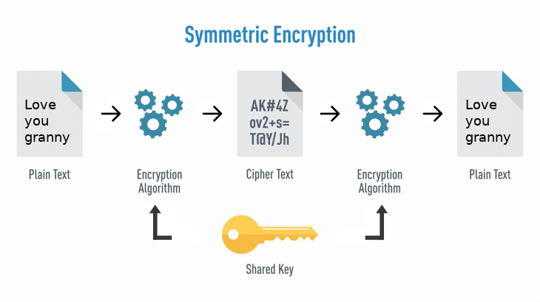
https://cdn-images-1.medium.com/max/1600/1*mnyITCNnRdeLfauh3Psmlw.png

Slide 5
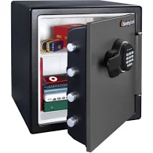




Analogy of Symmetric Cryptography
For centuries it was believed that sender and receiver need to know the same secret.

Slide 6
Problems of Symmetric Cryptography:
fast but
Too many keys: In a network, each pair of users requires an individual key
Key distribution problem: The secret key must be transported securely

Slide 7
Problem 1: Too many keys
https://www.cryptool.org/en/ct1-downloads

Slide 8
Key Distribution Problem
Both parties must possess a secret key which they must exchange prior to using any encryption
How?
it involved face-to-face meeting (impractical and always unsafe)
use of a trusted courier, or (impractical and always unsafe)
sending the key through an existing encryption channel. (chicken & egg problem)

Slide 9
Asymmetric cryptography
Solving the problems through asymmetric cryptography

Slide 10
Solving the problems through asymmetric cryptography
Don’t need to manage many keys
Use one-time session key
Generate a session key before each session, throw it away after one-time use.
Don’t need to exchange the secret key face-to-face
Can exchange secret key online

Slide 11

Main idea of asymmetric cryptography: a key pair
Private key
Public key
Public key

Slide 12
Basic Protocol for Public-Key Encryption

Slide 13
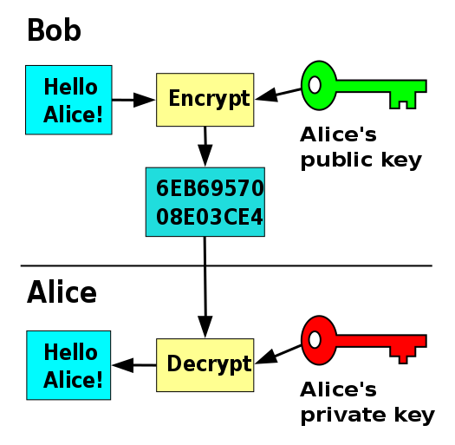

Slide 14
So do we still need symmetric cryptography?
Symmetric encryption methods have better performance

Slide 15
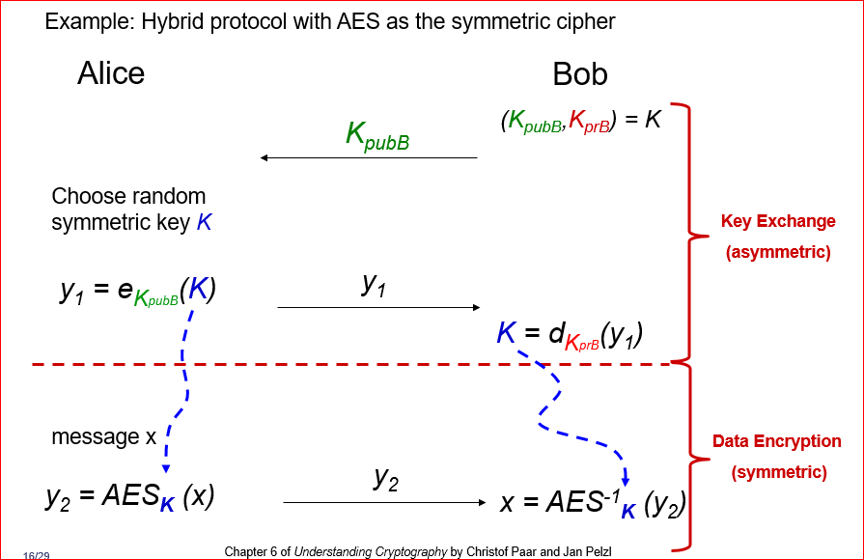
Hybrid systems

Slide 16
Essential Number Theory for Public-Key Algorithms

Slide 17
Example of public key and private key
3 . 7 ≡ 1 mod 20
Public key
Private key
Modular Inverse

Slide 18
Verify public key and private key use 14
3 . 7 ≡ 1 mod 20
Encryption : A³ mod 33 =? 5
14*14*14 mod 33=?
Decryption: 5⁷ mod 33 =? 14
Public key
Private key
https://planetcalc.com/8326/

Slide 19
Questions
Encryption: 14³ mod 33 =? 5
Decryption: 5⁷ mod 33 =? 14
3 . 7 ≡ 1 mod 20
How to get 3 and 7 (this lecture)
Where 33 comes from? (next Lecture)
Public key
Private key

Slide 20
Questions
Encryption: 14³ mod 33 =? 5
Decryption: 5⁷ mod 33 =? 14
How to get 3 and 7?
Where 33 comes from? (next lecture)
3 . 7 ≡ 1 mod 20
Pick 3, and compute t, such that
3 . t ≡ 1 mod 20
Public key
Private key
33 is part of public key, 20 is not
The relation between 33 and 20 makes the algorithm secure
So: more precisely: (3, 33) is a public key, 7 is a private key

Slide 21
Two methods to find modular inverse of 3
3 . t ≡ 1 mod 20
t=0,1,2,3,…….19 (hard way)
Apply Extended Euclidean Algorithm (easy way)

Slide 22
Use Extended Euclidean Algorithm for computing reverse
(part 1: GCD)

Slide 23
Need to understand greatest common divisor (GCD)
GCD (24,18)=6
2 |24 18
3 |12 9
4 3
24=2*2* 2*3
18=2*3*3
Traditional method (factorization):
Factoring is complicated (and often infeasible) for large numbers
Better method (Extended Euclidean Algorithm) : gcd(24,18)=gcd(18,6)=gcd(6,0)

Slide 24
gcd(67,12) using Extended Euclidean Algorithm
gcd (67, 12) = gcd (5 . 12+7, 12) //67= 5 . 12+7
gcd (12, 7) = gcd (1 . 7+5, 7) // 12= 1 . 7+5
gcd (7, 5) = gcd (1 . 5+2, 5) // 7 = 1 . 5+ 2
gcd (5, 2) = gcd (2 . 2+1, 2) // 5 = 2 . 2+ 1
gcd (2, 1) = gcd (2 . 1+0, 1) // 2 = 2 . 1+ 0
gcd (1, 0) = 1

Slide 25
Another example
gcd (84, 30) = gcd (2 . 30+24, 30)
gcd (30, 24) = gcd (1 . 24+6, 24)
gcd (24, 6) = gcd (4 . 6+0, 6)
gcd (6, 0) = 6

Slide 26
Use Extended Euclidean Algorithm for computing reverse
(Part 2: Use GCD)

Slide 27
Extended Euclidean Algorithm for comuting t: 3 . t ≡ 1 mod 20
gcd(20, 3 ) | 20=(6) 3+2
gcd(3, 2) | 3=(1)2+1
gcd(2, 1) | 2=(1)1+0
gcd(1, 0) | 1=(1)0+1
 |  | 1=3-(1)2 1=3-(1)[20-(6) 3] 1=3- 20+(6) 3 1=- 20+(7) 3 1 mod 20 = [- 20+(7) 3] mod 20 1 mod 20 = (7) 3 mod 20 3 . 7 ≡ 1 mod 20

Slide 28
(another example ) Two methods to find modular inverse of 12 mod 67
12 . t ≡ 1 mod 67
t=0,1,2,3,…….66 (hard way)
Apply Extended Euclidean Algorithm (easy way)

Slide 29
GCD(67,12): Extended Euclidean Algorithm
gcd(67,12)
67=(5)12+7
12=(1)7+5
7=(1)5+2
5=(2)2+1
2=(2)1+0 | 1=5-(2)2 1=5-(2)[7-(1)5] 1=(3)5-(2)7 1=(3)[12-(1)7]-(2)7 1=(3)12-(5)7 1=(3)12-(5)[67-(5)12] 1=(28)12-(5)*67

Slide 30
Important conclusion
We can find t 12 . t ≡ 1 mod 67 , if gcd(12, 67)=1, where t is the inverse of 12 mod 67
gcd (r₀ , r₁ ) = 1 in order for the inverse to exist, r₁ . t ≡ 1 mod r₀
(r₁ , t ) is a pair of key

Slide 31
Homework: find modular inverse of 13 mod 67
13 . t ≡ 1 mod 67
Two methods
t=0,1,2,3,…….66 (hard way)
Apply Euclidean Algorithm

Slide 32
Review Questions
Explain the key distribution problem.
What is the main motivation of the designing the asymmetric cryptography?
Discuss the differences between the symmetric and asymmetric cryptography? You can compare (1) the key choice, (2) the encryption/decryption performance, (3) the design purpose

